Slide 1
Software Requirements Specification Report
Team LER: APH O&M Alexa Skill
Eric Schulze, Ryan Gosling, Larome Dickerson

Slide 2
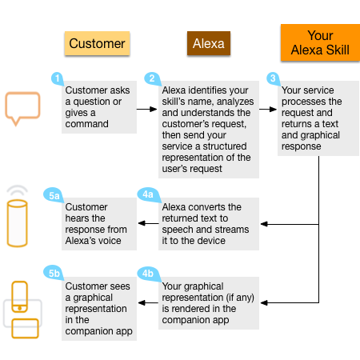
System Overview
The Alexa skill will consist of two individual parts working in tandem with each other, the Interaction Model and the Hosted Service.
The Interaction Model is a voice user interface (VUI) for the Alexa skill. The Interaction Model is to the skill, what a graphical user interface is to a mobile application; it defines how a user is able to interact with our skill. This Interaction model includes the intents and utterances that a user can use. The intents and utterances trigger responses based on the second part of the skill, the Hosted Service.
The hosted service is the brains behind how Alexa handles responses and phrases from the user. The hosted service takes as input intents, deciphered from the user utterance by the VUI, and outputs response phrases.

Slide 3
Interfaces
System, Software, Communication
The APH O&M Skill interfaces with the Amazon Alexa devices and applications through the Amazon Alexa service and the Lambda Amazon Web Service. The Lambda service will host our code for the Hosted Service and get called by the Amazon Alexa service whenever our skill is requested.
User
Users will interact with the APH O&M Skill through the Amazon Alexa Service. There will be a number of invocation functions and in-skill functions. All functions will be accessed through the VUI or Interaction Model.
Hardware
The APH O&M Alexa Skill will work on any device that supports the Amazon Alexa service. This can include Amazon Echo, Show, Link devices, as well as the Alexa mobile application for iOS and Android operating systems. The Alexa service will provide all hardware support for these devices.

Slide 4
Product Functions
Constraints
Requirements
3 stages:
Outside of Skill: Start Skill (goes to main menu), Start New Games, Resume paused games
From Main Menu: Start New Game, Resume paused game, Exit skill
Inside a Game: Exit game (goes to main menu, does not save game), Pause game (goes to main menu, does save game), Exit skill
Design Constraints
The skill can only use VUI
No memory on device.
Other Constraints, Assumptions, Dependencies
Fully, 100% dependent on Amazon service. Cannot run if amazon site goes down.
External Interface Requirements
Communicate with database to save state.
Communicate with database to get questions and answers and sound files.
Functional Requirements
Needs to play sound files
Needs multiplayer access
Set different difficulties for different players
Have multiple choice and true/false questions
Maintainability
Be able to update questions easily.

